Slide 1


School of Computing Science and Engineering

Slide 2

School of Computing Science and Engineering
Subject Name: Data Analytics Excel Tableau Subject Code: BCS01T1001
CAT-3 Presentation
Topic Name→ Histogram and Descriptive Statistics
Programme Name: B.Tech. (CSE)
Section: 2
NAME:-
NIKHIL JAIN (21SCSE1010727)
SHIVAM PACHAURI (21SCSE1010589)
ADITYA KUMAR (21SCSE1010293)
VISHAL KUMAR JHA (21SCSE1010577)
AAYUSH KUMAR (21SCSE1011211)
Group Number: 11

Slide 3
TABLE OF CONTENT:-
TABLE OF CONTENT
Histogram
Importance of Histogram
How to make Histogram
Conclusion
Descriptive Statistics
How to make Descriptive Statistics
Reference

Slide 4

Histogram
Histogram A histogram is a graphical representation that organizes a group of data points into user-specified ranges. Similar in appearance to a bar graph, the histogram condenses a data series into an easily interpreted visual by taking many data points and grouping them into logical ranges or bins.
Importance of a Histogram Creating a histogram provides a visual representation of data distribution. Histograms can display a large amount of data and the frequency. The function will calculate and return a frequency distribution. We can use it to get the frequency of values in a dataset.

Slide 5
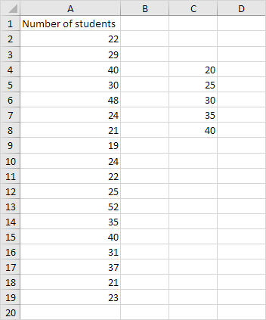
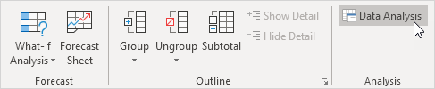
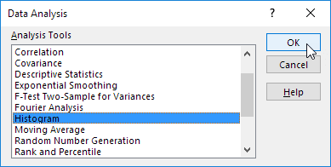
How to make a histogram
To make a Histogram Firstly you want to check data analysis tool package installed or not →
Step-1. First, enter the bin numbers (upper levels) in the range C4:C8.
Step-2. On the Data tab, in the Analysis group, click Data Analysis.
Step-3. Select Histogram and click OK.

Slide 6
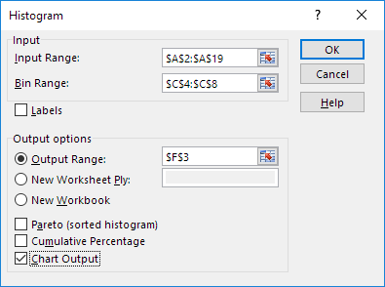
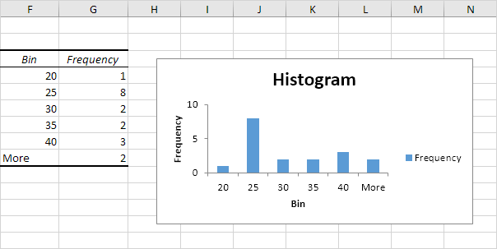
Histogram
Step-4. Select the range A2:A19.
Step-5. Click in the Bin Range box and select the range C4:C8.
Step-6. Click the Output Range option button, click in the Output Range box and select cell F3.
Step-7. Check Chart Output.
Step-8. Click OK.

Slide 7
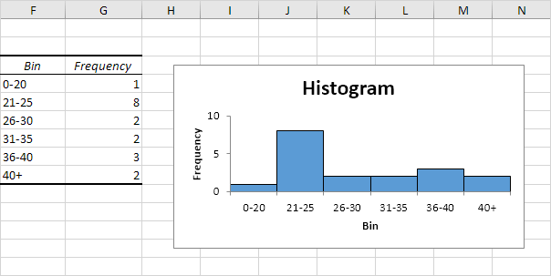
Histogram
Step-9. Click the legend on the right side and press Delete.
Step-10. Properly label your bins.
Step-11. To remove the space between the bars, right click a bar, click Format Data Series and change the Gap Width to 0%.
Step-12. To add borders, right click a bar, click Format Data Series, click the Fill & Line icon, click Border and select a color.

Slide 8
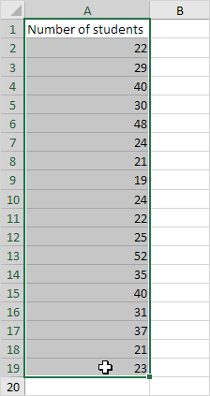
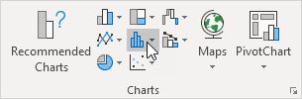
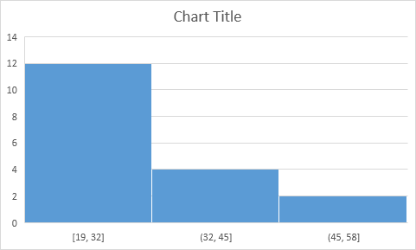
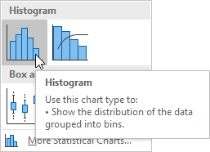
Histogram
Note:- If you have Excel 2016 or later, simply use the Histogram chart type.
Step-13. Select the range A1:A19.
Step-14. On the Insert tab, in the Charts group, click the Histogram symbol.
Step-15. Click Histogram.
Result. A histogram with 3 bins.

Slide 9
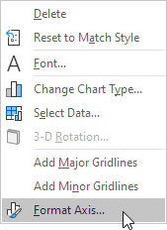
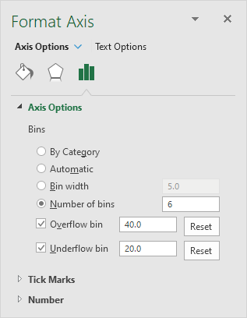
Histogram
Note: Excel uses Scott's normal reference rule for calculating the number of bins and the bin width.
Step-16. Right click the horizontal axis, and then click Format Axis.
The Format Axis pane appears.
Step-17. Define the histogram bins. We'll use the same bin numbers as before (see first picture on this page). Bin width: 5. Number of bins: 6. Overflow bin: 40. Underflow bin: 20.

Slide 10
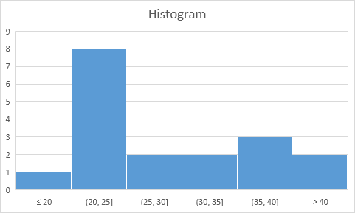
Histogram
Result:
Recall, we created the following histogram using the Analysis ToolPak (steps 1-12).
Conclusion: the bin labels look different, but the histograms are the same. ≤20 is the same as 0-20, (20, 25] is the same as 21-25, etc.

Slide 11
Descriptive Statistics
Descriptive Statistics
Descriptive statistics are used to describe or summarize the characteristics of a sample or data set, such as a variable's mean, standard deviation, or frequency. Inferential statistics can help us understand the collective properties of the elements of a data sample.
Descriptive statistics are used to describe the basic features of the data in a study.
They provide simple summaries about the sample and the measures.
Together with simple graphics analysis, they form the basis of virtually every quantitative analysis of data.

Slide 12
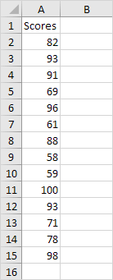

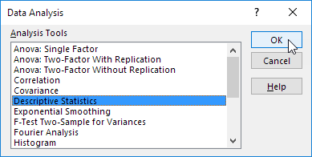
How to make Descriptive Statistics
You can use the Analysis Toolpak add-in to generate descriptive statistics. For example, you may have the scores of 14 participants for a test.
To generate descriptive statistics for these scores, execute the following steps.
Step-1. On the Data tab, in the Analysis group, click Data Analysis.
Step-2. Select Descriptive Statistics and click OK.

Slide 13
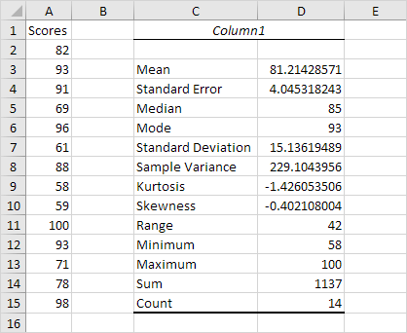
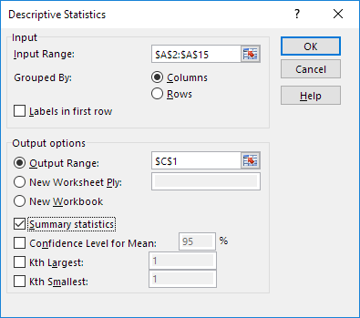
Descriptive Statistics
Step-3. Select the range A2:A15 as the Input Range.
Step-4. Select cell C1 as the Output Range.
Step-5. Make sure Summary statistics is checked.
Result:
Step-6. Click OK.

Slide 14
Reference
Reference:
Slide Share
Text Books
3. Internet of Things

Slide 15
School of Computing Science and Engineering
Thank You…..

